Slide 1
REALTIME DENSITY SENSOR

Slide 2

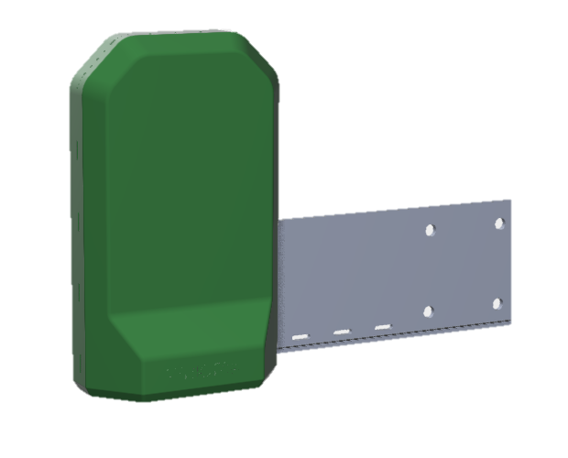
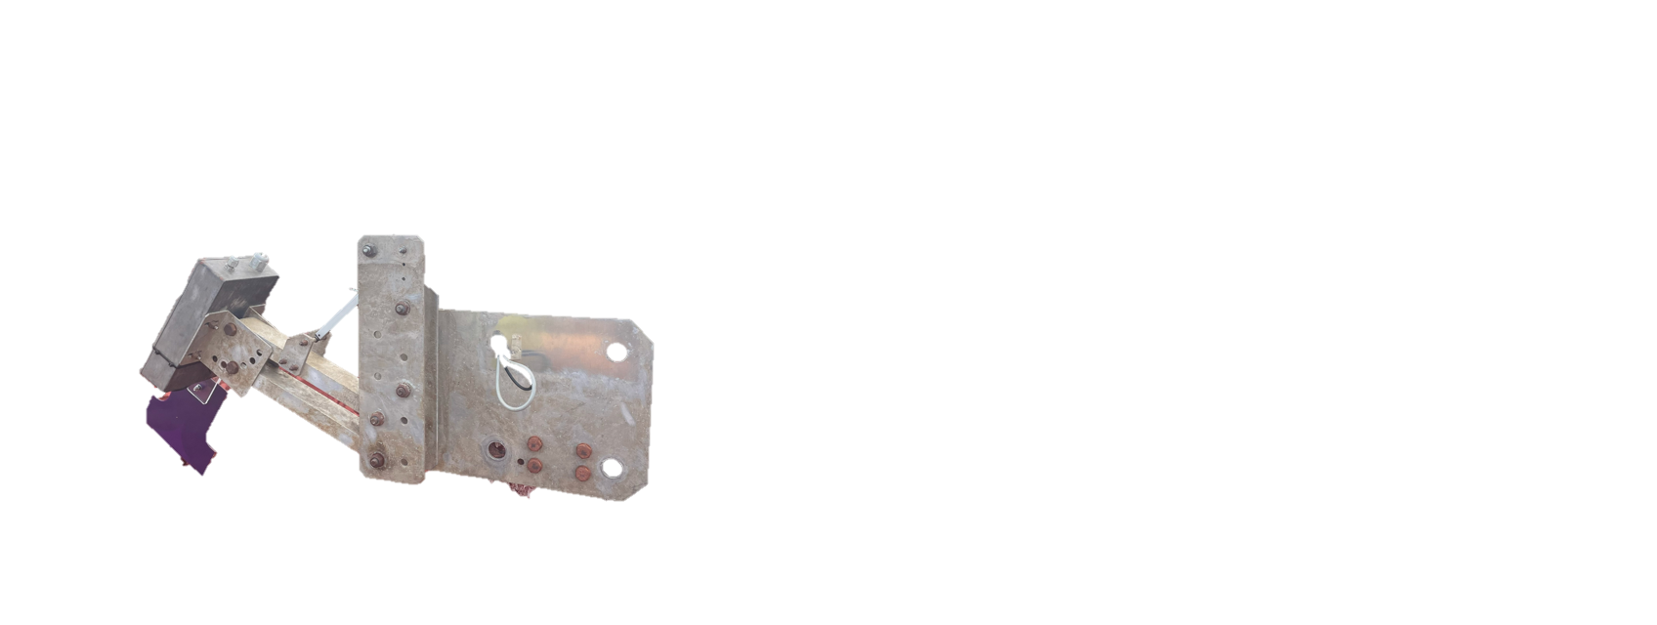
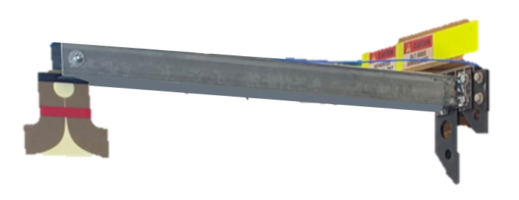
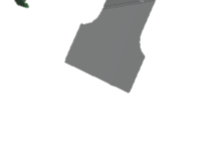
REALTIME DENSITY SENSOR
JULY 2020
JULY 2022
JULY 2023
Real-Time Density Sensor
Using radio technology to predict tailings density, this system provides real-time data, improving process control and optimising material handling.

Slide 3
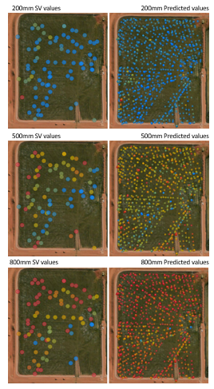
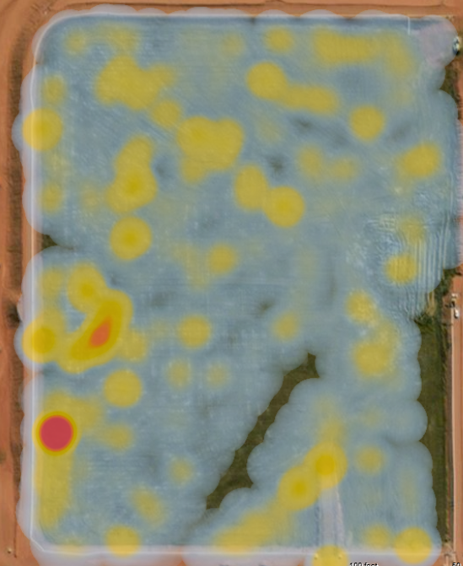
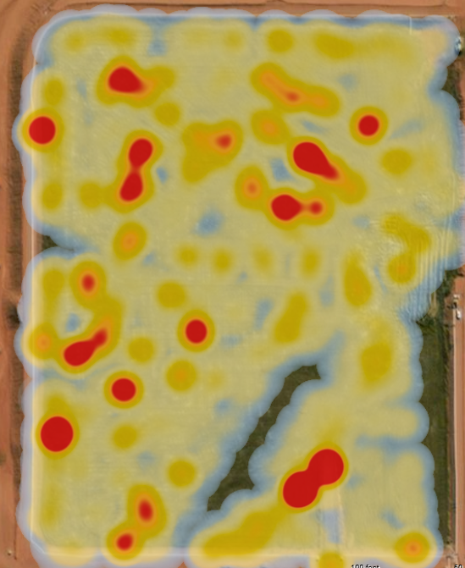
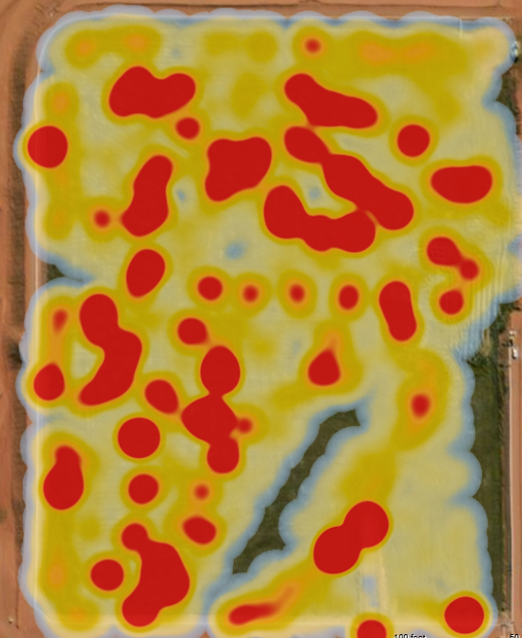
WHAT WE HAVE ACHIEVED
DATA SOURCES
Very Soft
Soft
The Realtime Density Sensor was deployed in Mount Weld, Laverton (Rare Earths).
The results are a combination of two parts:
Collected values from Density Sensor every 10 seconds
Collected values from Shear Vanes samples every 10 minutes
Medium
Firm
1000mm ↓
THE DEEPER WE GO, THE LOWER THE RESOLUTION OF THE PREDICTABILITY

Slide 4
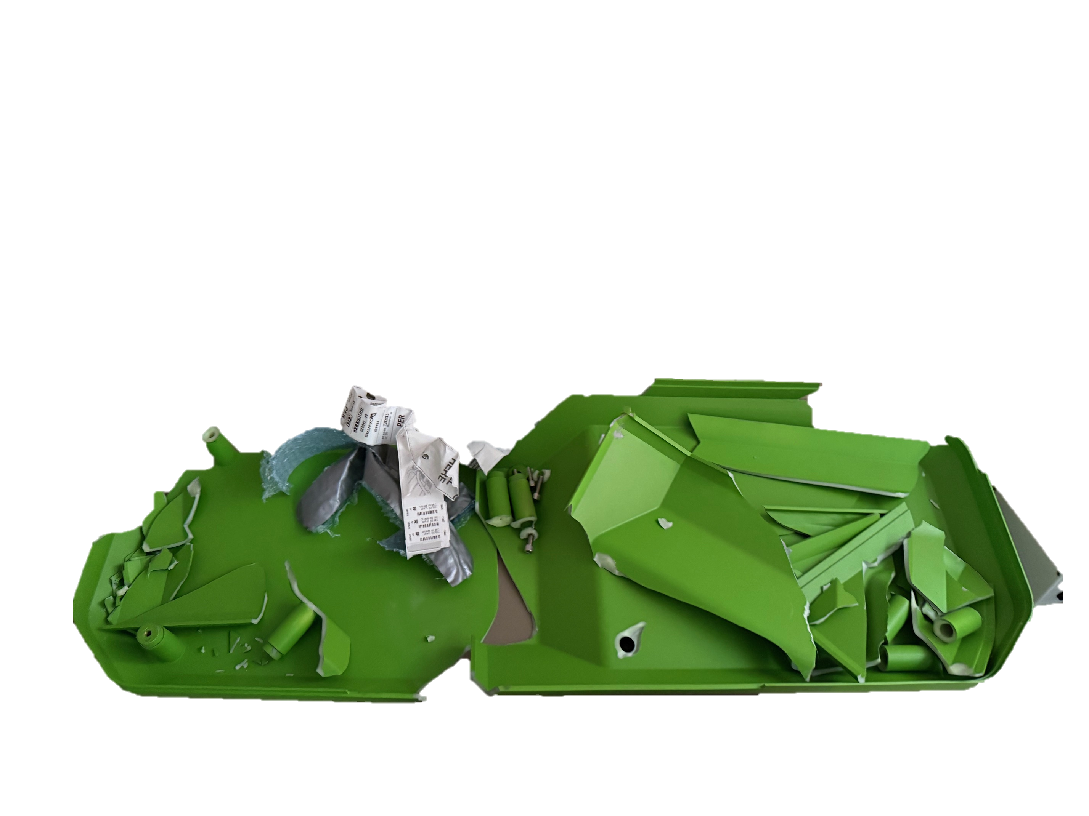
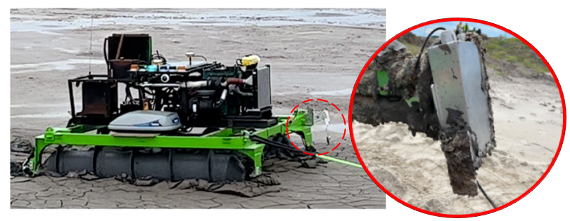
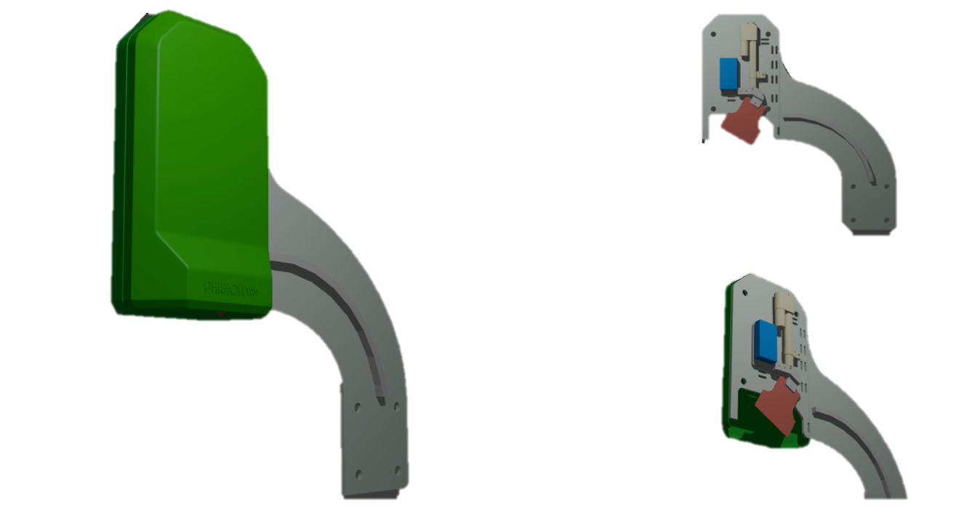
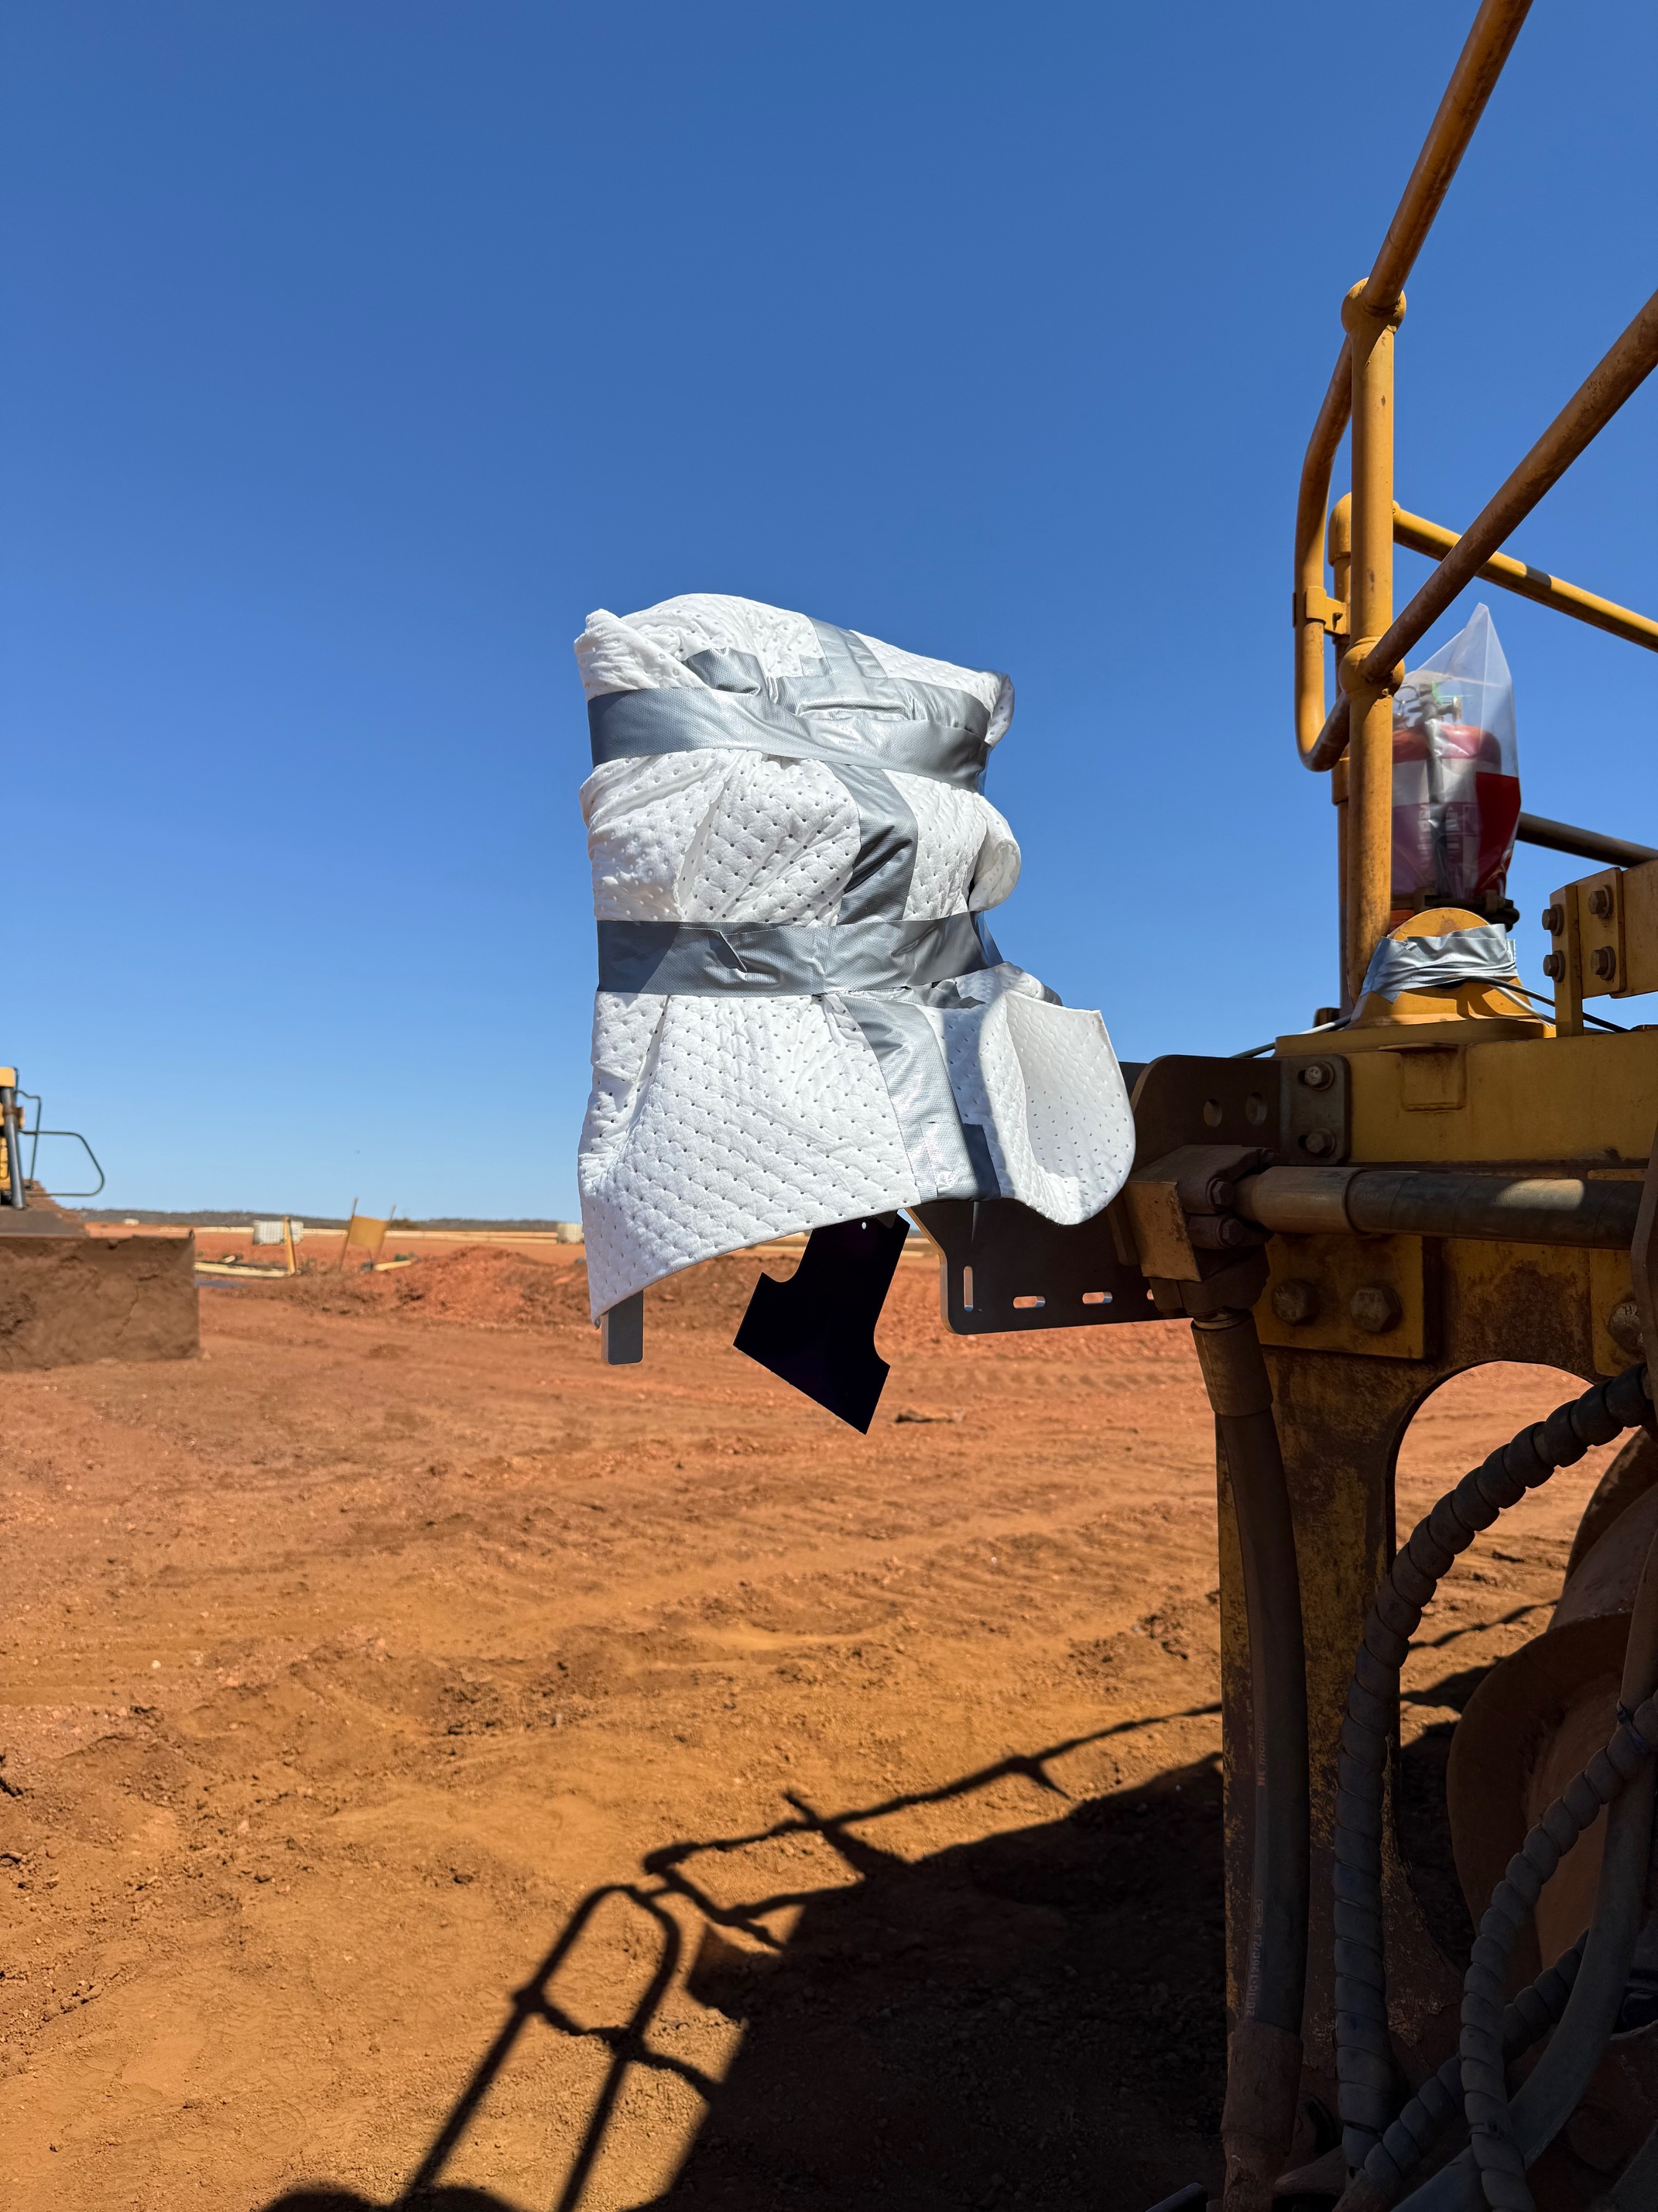
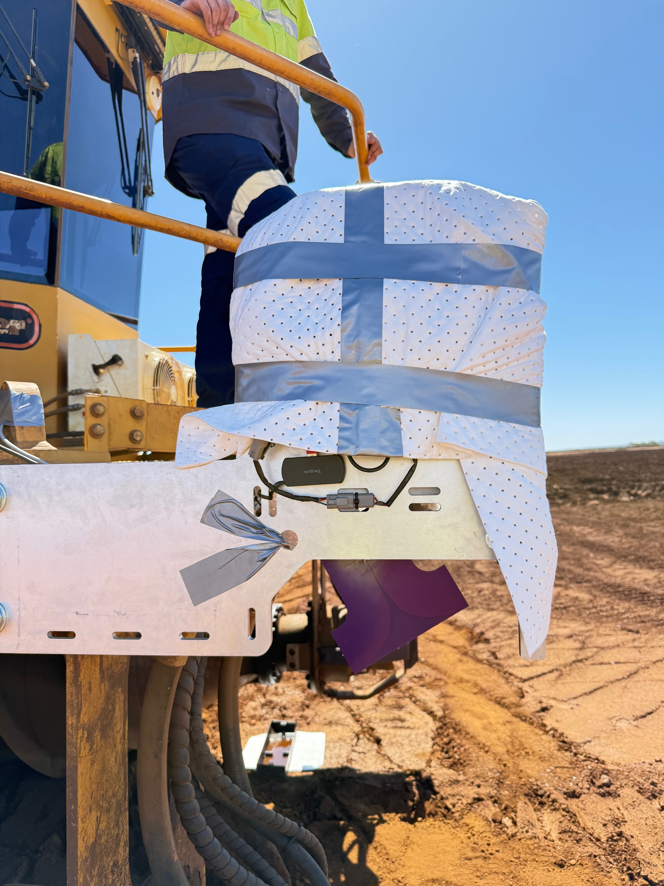
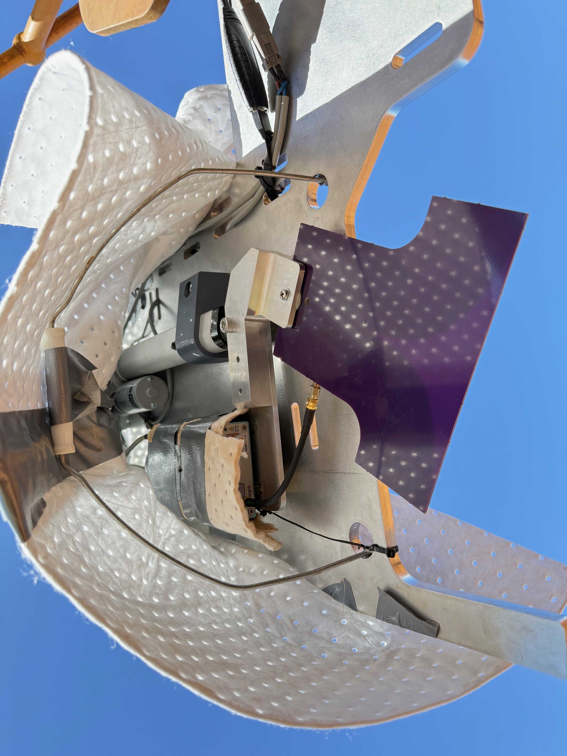
SO, WHAT HAS CHANGED?
DATA SOURCES
LESSONS LEARNED!
Material
Heat
Height
+300mm

Slide 5
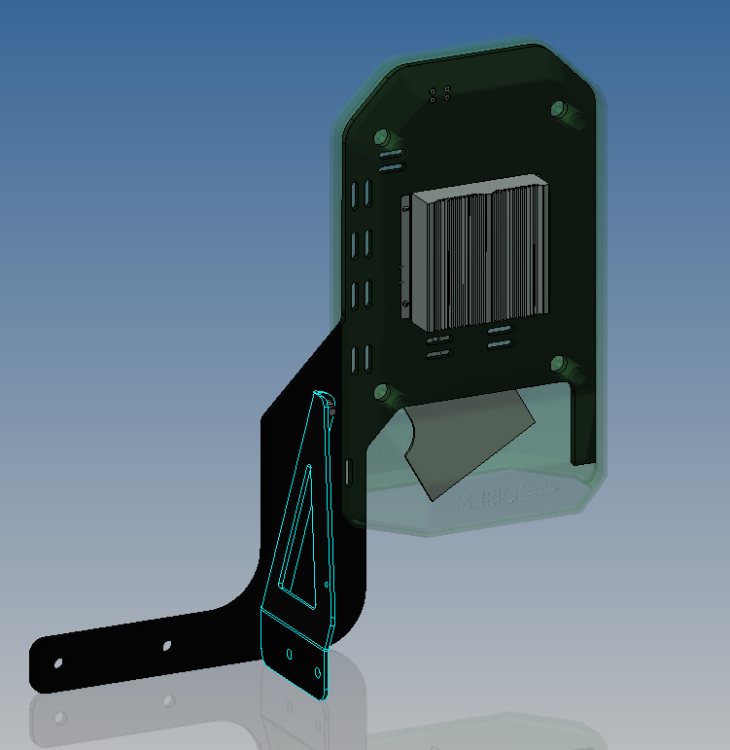
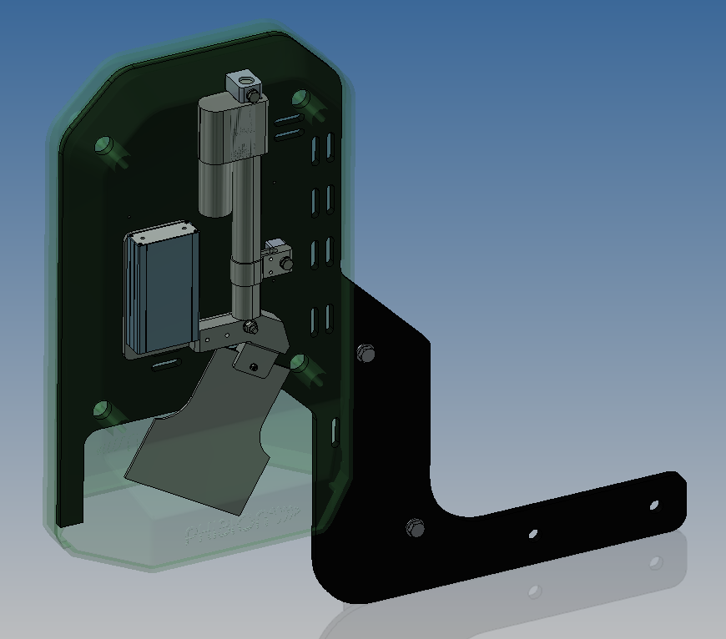
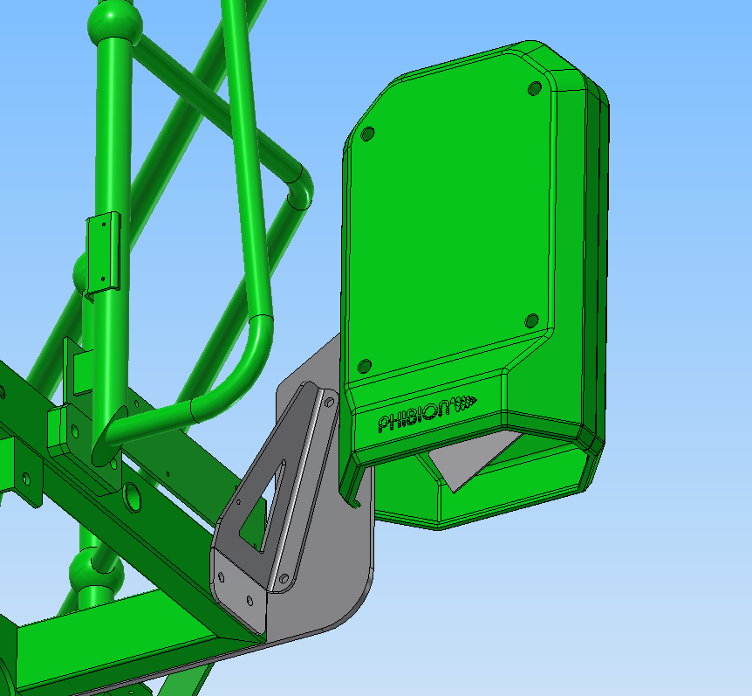
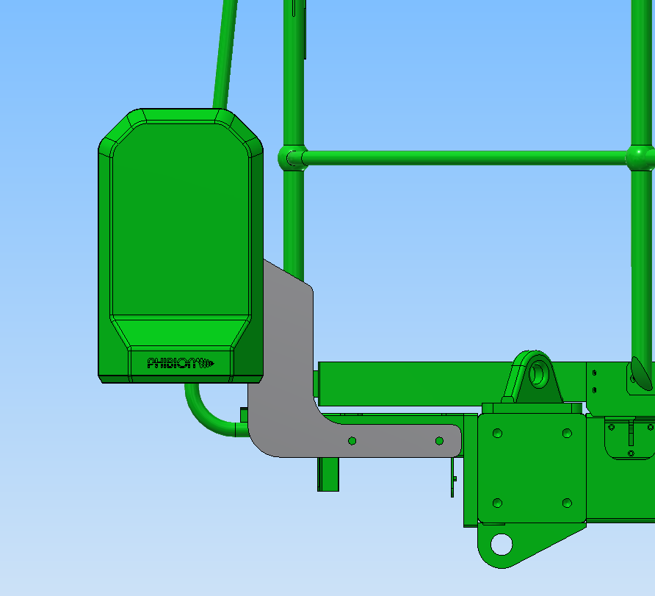
PHYSICAL DESIGN IMPROVEMENTS
DATA SOURCES
Mount / Frame material: 10.0mm Alu 5083 Grade, Black Anodised finish
Mounting location change: from Jacking Legs to front of Chassis
Cover assembly: 3D print or plastic mould … TBD
Cover Assembly change: Splash Guard to prevent material from entering cavity (not currently displayed)

Slide 6
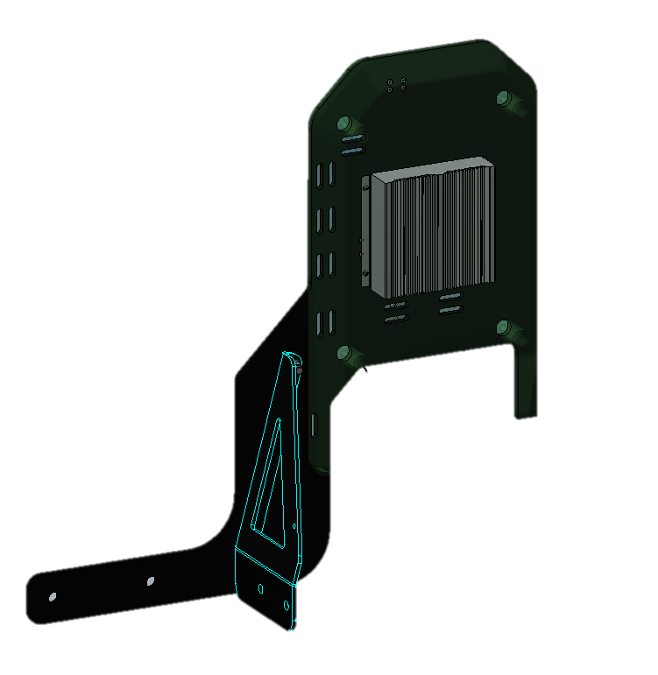
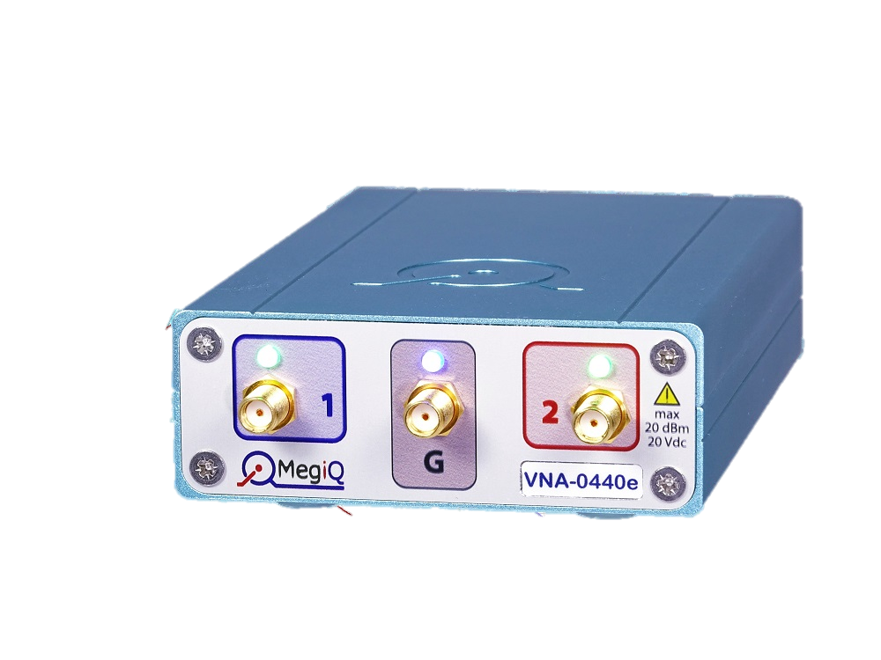
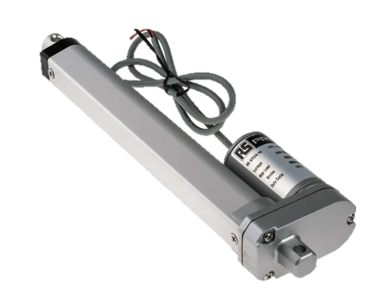

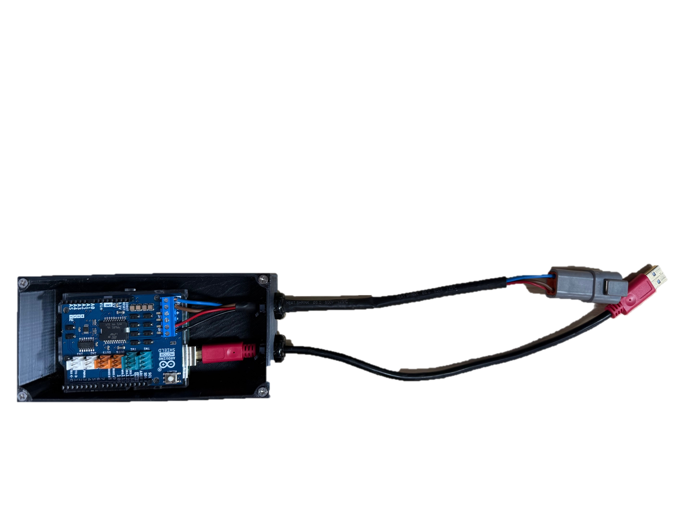
BILL OF MATERIALS
DATA SOURCES
Mount / Frame: $800
VNA: $5,000
Onboard Computer: $100
Computer Housing: $20
Actuator: $420
Internal Cables: $100
Vivaldi Antenna: $120
Frame Ancillaries: ~$400
Cover Assembly: ~$500
Harness: ~$500
Assembly: Inhouse
$7960
+ Assembly
+ Installation
+ Commissioning

Slide 7
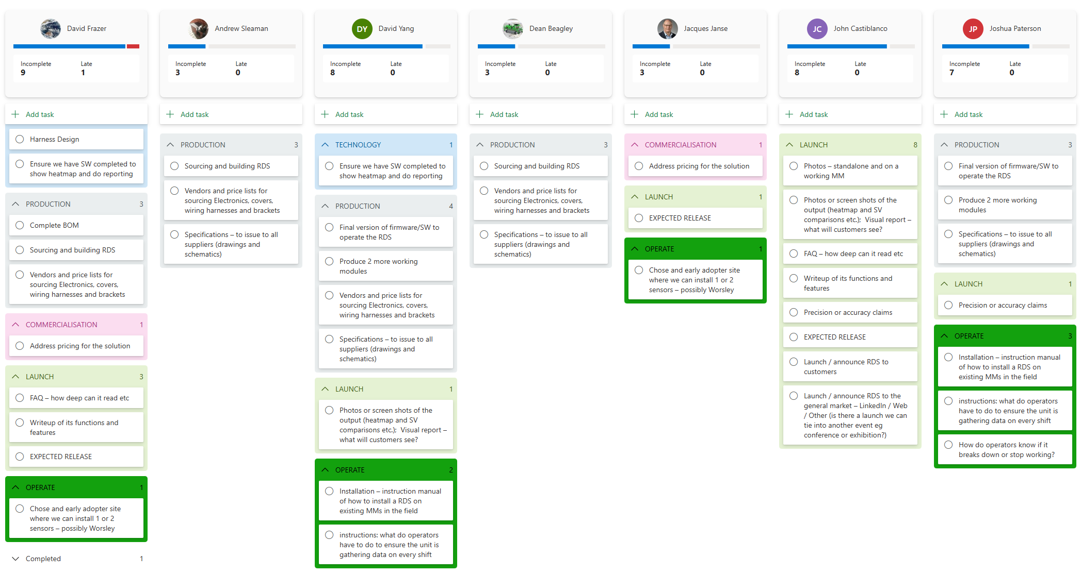
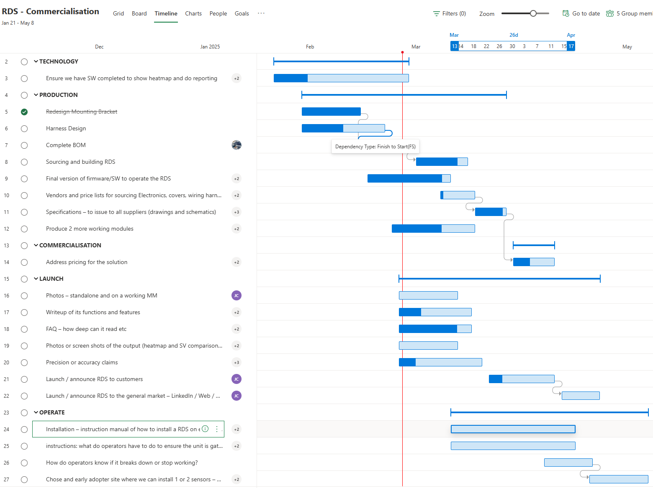
HOW ARE WE PROGRESSING?
DATA SOURCES

Slide 8
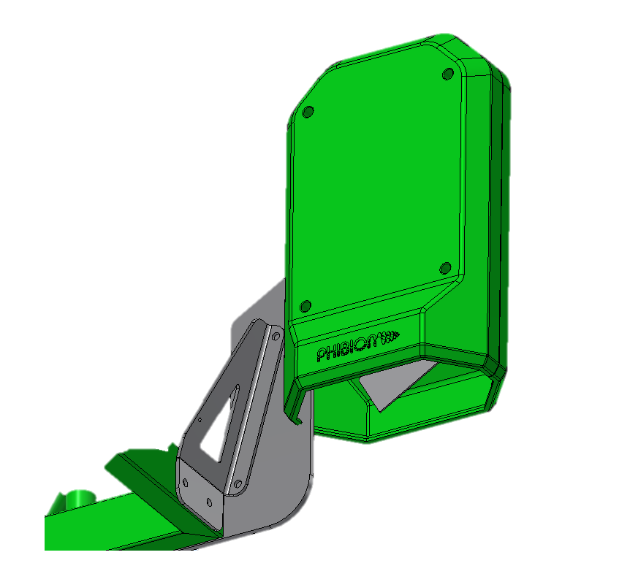




DELAYED: WHEN & WHY
JULY 2020
JULY 2022
JULY 2023
JULY 2025
Data collecting & Preprocessing
Data Integration
Machine Learning
WE HAVE CHANGED THE WAY THE WE COLLECT DATA
WE HAVE INCREASED OUR UNDERSTANDING OF DATA INTEGRTION
WE HAVE RESEARCHED AND
TESTED ACROSS VARIOUS MACHINE LEARNING MODELS

Slide 9
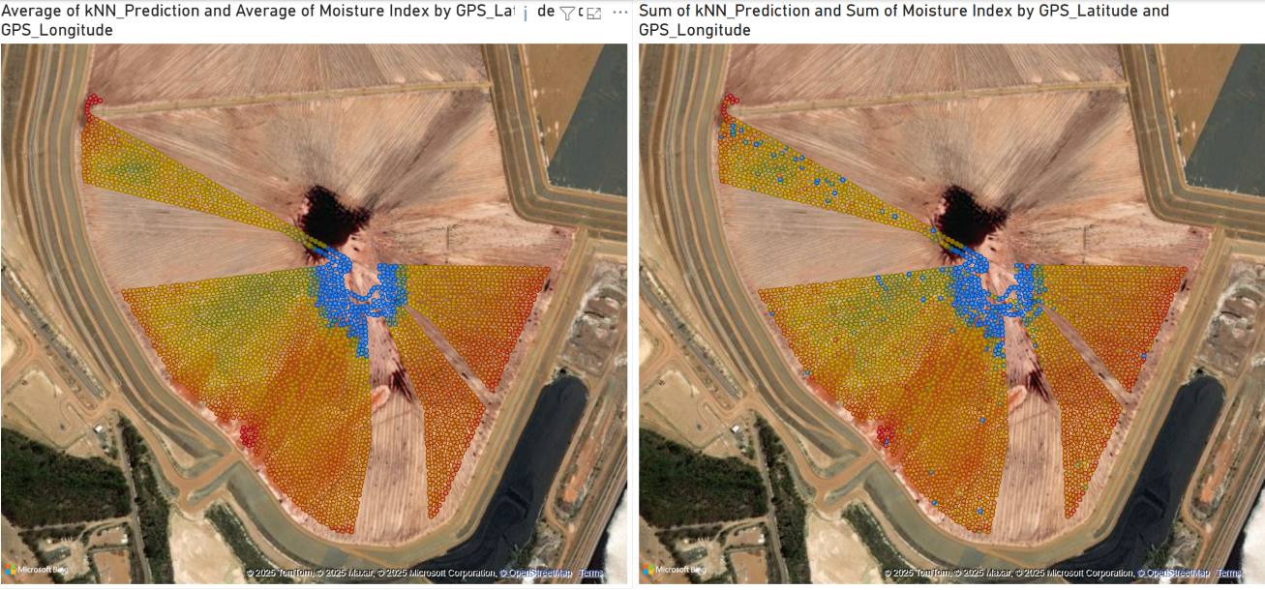

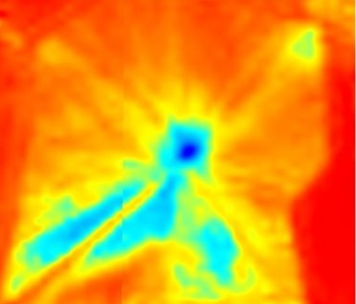
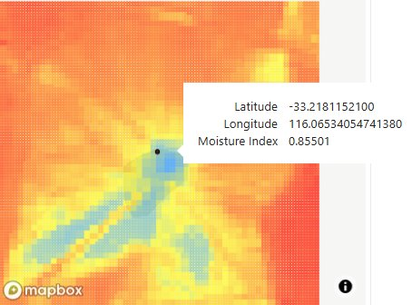
A GLIMPSE INTO THE FUTURE
Extended research has been conducted to seek a correlation / validation means to tie MudMaster performance into the Density Sensor prediction model.
These values include:
Engine Torque
Scroll Traction
GPS Speed
Traction Difference
Sentinel-2 Satellite
Worsley
2025/01/27
MudMaster MoTeC
Worsley
2025/01/27
SATELLITE-BASED MOISTURE IMAGERY
MOTEC DRIVEN - POWERBI REPORTING

Slide 11




Slide 12
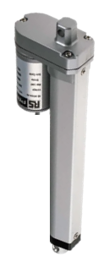
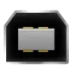
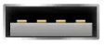
~10m USB-A Male (in cab) to USB-A Female (Antenna)
~10m 12v cable (at Fuse block to the Antenna)
12v Connector block to in-cab Fuse
500mm
+
-
+
-
USB Mini B
Bare wire into Arduino Power/In and Power/Out
USB-B Plug in
500mm
USB-B
USB-B
USB-A
Into Arduino PC
USB-A
500mm
500mm
500mm
2 in 1 out
USB Hub (Targus ACH214)

